Slide 1

McCarthy Uniforms
Back to School 2020
Communication Package for Schools
July - August 2020 Updates

Slide 2

SUGGESTED LETTER / EMAIL MESSAGING
Notes:
So looking forward lets take everything we learned.

Slide 3
Note: This text and accompanying message can be cut and paste into an email and distributed from your school to incoming & existing families.
There are three ways to shop for your school uniform: 1. Your School E-Store Did you know your school has a custom e-store, complete with fit videos, uniform guides and specialized advice? Visit your school store by 'searching for your school' on McCarthy Uniforms’ home page. McCarthy’s recently launched a handy web chat feature and have staffed their call-centre so that you can have the support you need if you need some help along the way ! Online shoppers can also now enjoy the industry's first flexible payment plan (interest-free payments over six weeks !).
Shop online by ‘searching for our school’ at: www.mccarthyuniforms.ca
2. Private Appointments Available Until August 15 McCarthy’s is booking private appointments until August 15th, as well as accepting limited walk-in customers. You can use McCarthy’s handy appointment booking tool to reserve your spot and avoid being disappointed by capacity limits. Beginning August 16, McCarthy’s expects longer-than-average wait times for walk-in traffic (due to government mandated 'six feet’ social distance measures). To guarantee your fitting and avoid long lines, book an appointment for prior to August 15.
Book a personalized fitting by choosing ‘book an appointment’ at: https://www.mccarthyuniforms.ca/
3. Your School Call Centre Your call-centre is open for shopping ! By giving McCarthy’s a shout at 416-593-6900 or toll-free at 1-800-668-8261 Alex and his team would be happy to assist you with your school uniform purchase or questions ! McCarthy’s call centre is staffed with uniform specialists who know the ins & outs of our uniform policy.
Call McCarthy’s at: 416-593-6900 or 1-800-668-8261
Dear Families,
As we continue to navigate COVID-19 together, I am pleased to share an update on enhanced options for buying your school uniform in 2020.
Our school uniform provider, McCarthy Uniforms, has three enhanced options for shopping: Updated school e-stores, private appointments (prior to August 15th) and a web-supported call-center.
I encourage families to shop early and utilize these alternative channels to avoid late-August line ups. Long wait times will be the reality this year given that McCarthy’s must adhere to strict social distancing measures and simply can’t accept normal in-store volumes. The six feet social distance requirements translate into only 15% of McCarthy’s normal in-store capacity at peak time.
McCarthy’s has informed us that to support families during this time they have implemented an installment payment program (online only), introduced volume discount buying options and invested in a variety of web support tools to make online shopping easy & fast! All school uniform products can be exchanged for up to a year and returned until September 15.
Sincerely,
[insert name]

Slide 4
SOCIAL MEDIA TILES & MESSAGING
Notes:
So looking forward lets take everything we learned.

Slide 5
The goal of these social media tiles are to amplify key messages to ‘shop early’ and prepare families for virtual shopping options.
We have included two example social media tiles.
We recommend posting these tiles to your twitter, Instagram or facebook pages.
SOCIAL MEDIA TILES
How to use these messages
4

Slide 6
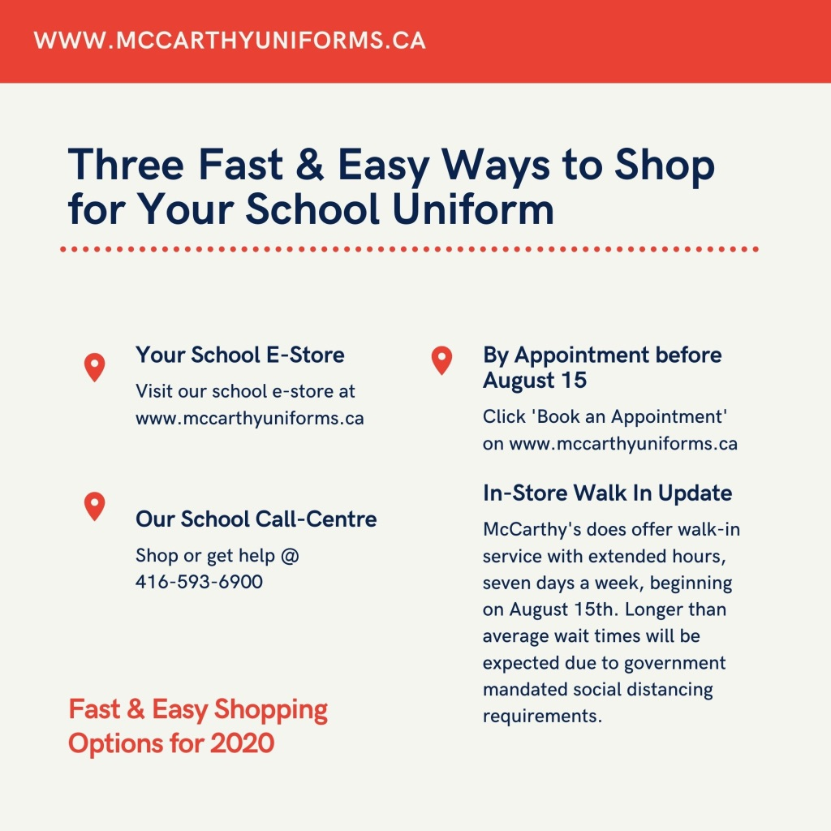
Suggested caption
Shop online, through the McCarthy call-center or take advantage of the opportunity to book a 1:1 appointment before August 15. All McCarthy Uniforms’ locations must adhere to social distancing guidelines which will cause longer-than-expected wait times for in-store shopping after August 15th.
Visit www.mccarthyuniforms.ca or call 416-593-6900
5

Slide 7

Suggested caption
Did you know our school has a custom e-store with call-center and web chat support? Avoid long lines and take advantage of easy installment payment options by visiting www.mccarthyuniforms.ca to shop for your 2020 school uniform !
6

Slide 8


